Slide 1
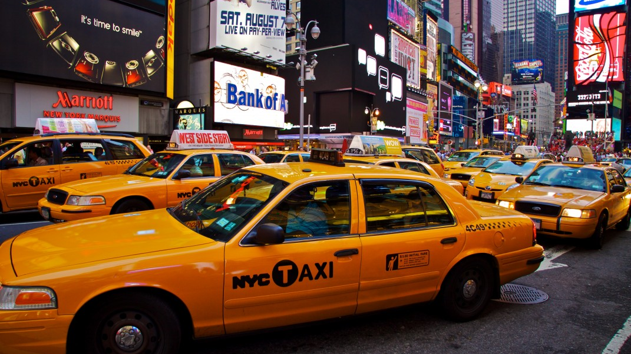
New York City Taxi Fare Analysis Using ML Optimizations
By Group 13
Chaitanya Kadian, Rohitashwa Ray Chowdhury

Slide 2
Motivation
Help daily commuters and travelers so that they do not get ripped off by dishonest taxi drivers. Travelers are charged more.
Develop a model that will predict very accurate fares between two places.
Can be used in combination with Uber and Lyft.

Slide 3
Introduction
Dataset by Google and Kaggle
Optimize and compare existing techniques
Dataset description
Predict: Fare Given: coordinates, start time, passenger count

Slide 4
The main objective is:
Predict fare
Consider all given data
Make sense of underlying causes and consider them

Slide 5
Exploratory Analysis
Pricing is dependent on distance travelled and time spent during ride.
Fare is increased for rides outside city limits.
There are 3 airports in the city. Fixed prices.
Tolls paid by customer.
There was a fee hike in late 2012.

Slide 6
Data Preprocessing and Exploration

Slide 7
Features: starting and ending coordinates, start time and passenger count
All negative fare value tuples are removed.
Some null value tuples are removed.
The coordinate values have some outliers. So we drop all tuples with coordinates outside a bounding box.
BB = (-74.5, -72.8, 40.5, 41.8)

Slide 8
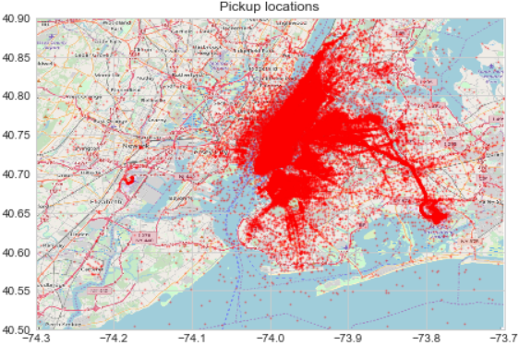
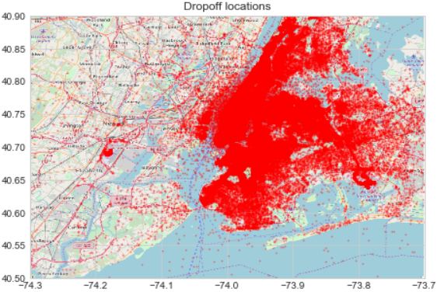
Plotted Points
Some coordinates are in water. These need to be dropped.

Slide 9
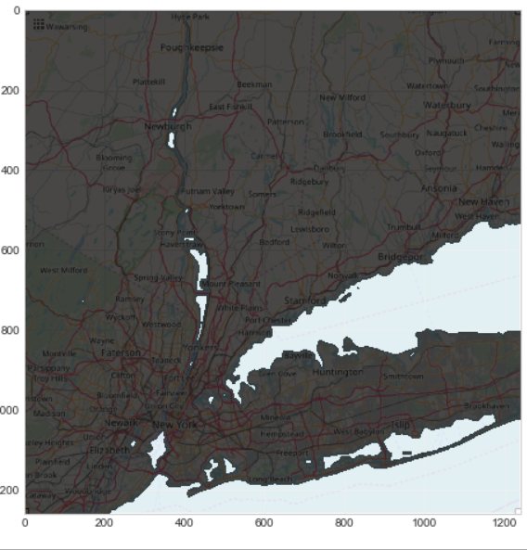
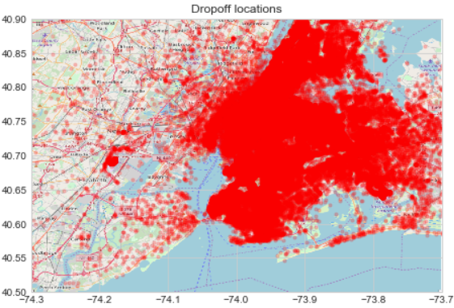
Plotted Points After Masking
We create a mask in photoshop of the image (top right), highlighting land mass and water.
All tuples with point in water are dropped.

Slide 10
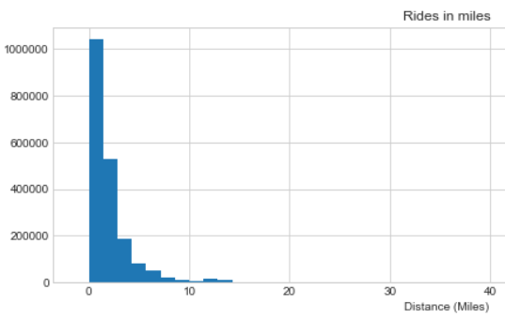
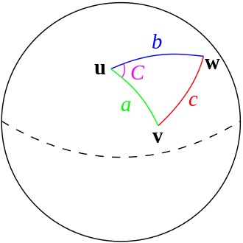
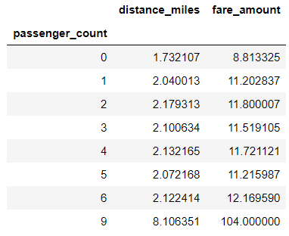
Distance and Passenger Count
We use haversine formula to calculate distance.
Plot of passenger vs fare tells that there is some correlation

Slide 11
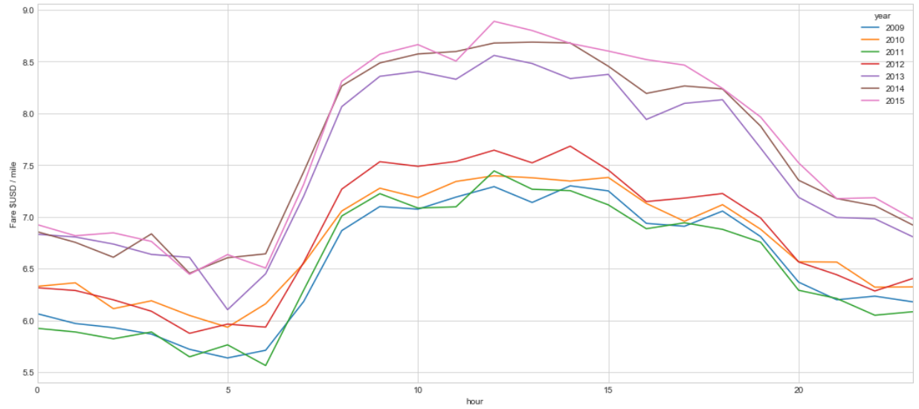
The fare increase after 2012 is apparent here.
The fare is somewhat dependent on hour of the day as well. Peak hours have higher “per mile fare”.
Could be due to traffic.

Slide 12
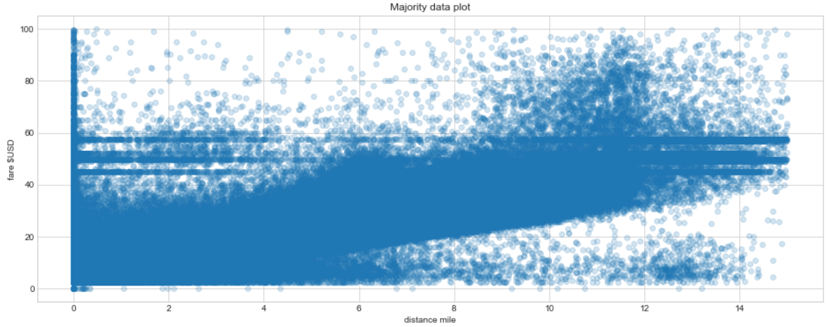
Some distance 0 rides have high fares. These are dropped
40-60 fare bracket has multiple rides. These are from airports. Airport rides have fixed rate irrespective of distance.
Otherwise a linear trend is observed, distance vs fare.

Slide 13
Models used in this project
Multi layer perceptron Regressor
Linear Regression
Random Forest Regressor

Slide 14
What is a Multi layer Perceptron?
MLP is a part of feedforward artificial neural network. It can act as both a classifier and a regressor. A MLP comprises of multiple layers of perceptrons. Generally a MLP will have a minimum of three layers which are: input layer, hidden layer, output layer.
MLP uses a supervised learning algorithm called backpropagation to train its model. Backpropagation starts from the output and goes back to make changes in every layer while reducing the error.
MLP differs from a linear perceptron due to its nonlinear activation function and thus handles non linear data quite efficiently.

Slide 15
What is Linear Regression?
Linear regression simply put is the relationship between a dependent variable with a set of independent variables. Dependent variables are generally dependent on a set of independent attributes for its value which may form a linear relationship between them.
A relationship that can be handled by a linear regression can be demonstrated graphically using a single straight line.
Linear regression handling multiple output or dependent values are known as multivariate linear regression.

Slide 16
What is Random Forest Regressor?
Random Forest is a type of ensemble learning algorithm that constructs a multiple number of decision trees to predict the outcome which is generally the mean prediction of the outputting classes. It can be used in classification or regression.
Random Forest is an ensemble method which means that it uses multiple algorithms together to generate the output.
Random Forest acts as a corrective measure for the decision trees habit of overfitting the training dataset. In this project we have used the algorithm for performing regression.

Slide 17
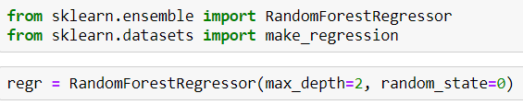

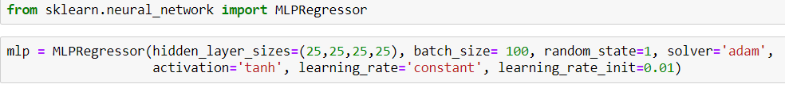
Training of the models
The three models mentioned have been trained using the default configuration without any further optimization. The dataset has been divided into 80:20 ratio where training set is 80% and testing set is 20%. The dataset used to train these models consists of 2 million rows.

Slide 18
Predictions and Hyperparameter Tuning
The fitted models were run on the X_test dataset and the root mean squared error was calculated for each prediction as a mean to measure the accuracy of the models. The sample solution provided by kaggle had a mean fare of $11.35 and the RMSE value of $5.74. So our objective is to get a lower value. We tuned the parameters of the given algorithms based on a number of important factors and ran the algorithms multiple number of times in order to reduce the RMSE value to its lowest possible value.
Out of the three models, hyperparameter tuning was performed on the random forest regressor and the Multilayer perceptron regressor models. The linear regression model was too simple to perform hyperparameter tuning. The process was very time consuming due to the massive size of the dataset. The whole process took almost two days to finish after running almost continuously.

Slide 19
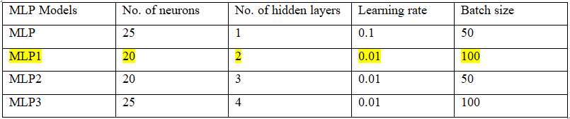
Hyperparameter tuning and Results obtained
MLP Regressor

Slide 20
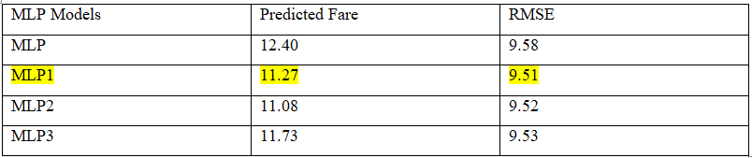
Hyperparameter tuning and Results obtained (contd.)
Results obtained after running on test dataset (4 lakh rows)

Slide 21
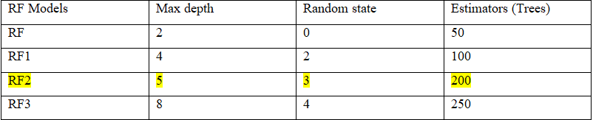
Hyperparameter tuning and Results obtained (contd.)
2. Random Forest Regressor

Slide 22
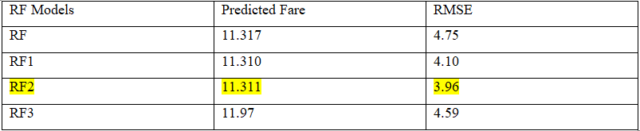
Hyperparameter tuning and Results obtained (contd.)
Results obtained after running on test dataset (4 lakh rows)

Slide 23
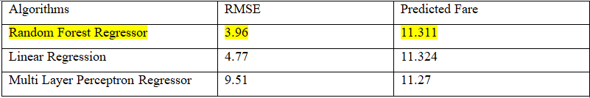
Final Results (based on the top 3 tuned models)
The Random Forest Regressor with RMSE of 3.96 is the best performing model.

Slide 24
Conclusion
In conclusion, it can be said that the project was successful as we managed to lower the given sample root mean square error value further down from $5.74 to $3.96. This was only possible with a Random Forest Regressor model with tuned parameters which had a max depth of 5, random state of 3 and estimator(trees) equal to 200. The mean price for this model was obtained to be $11.311. The simple linear regressor came a close second with a RMSE value of $4.77 and mean fare of $11.324. The worst performing algorithm was determined to be the MLP regressor. The best score obtained by the MLP models was with a RMSE value of $9.51 and a mean fare of $11.27. This was obtained with the help of a tuned MLP model with parameters such as number of neurons=20, number of hidden layers=2, learning rate=0.01 and batch size=100.

Slide 25

Future Scope
To further work on this project, more algorithms can be tried out and tuned further to lower the RMSE score even more. More nonlinear algorithms can be tried out to capture more intricacies within the data

